Slide 1
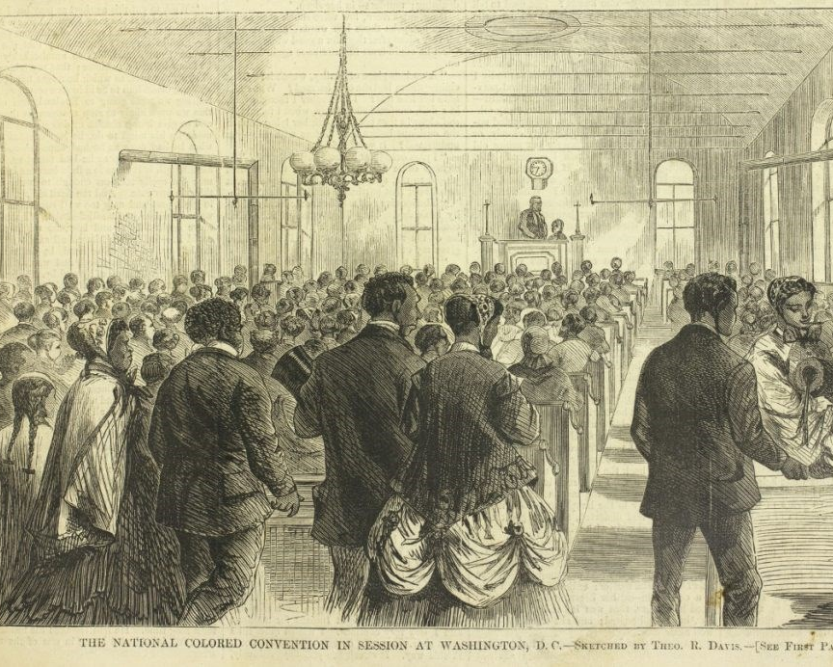
The 15th Amendment
By : Damile F.
AFN 124
April 6 , 2021
Prof. Remi Alapo

Slide 2
What was it?
It enables the federal government and each state from denying a citizen the right to vote based on that citizen's "race, color, or previous condition of servitude.

Slide 3
When was it Implemented ?
It was ratified in Iowa on February 3, 1870, as the third and last of the Reconstruction Amendments.”
WHY WAS IT NECESSARY ?
It was a significant change in the needed assistance for African American voting rights – it also set the foundation for future civil rights activism movements.

Slide 4
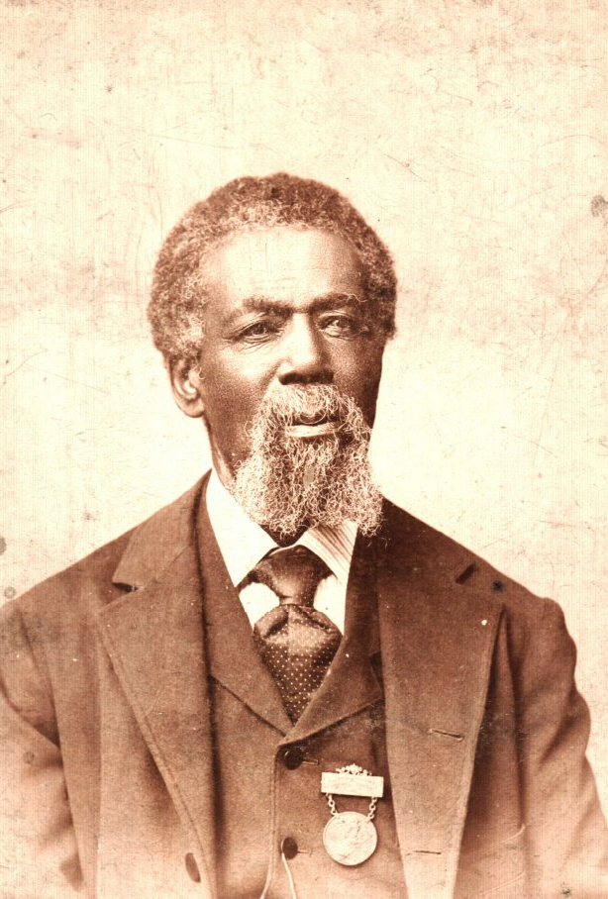
Who did it benefit?
While it may have seemed that the 15th Amendment could have benefited everyone, it only really guaranteed the right to vote to African American men. In fact, ” Thomas Mundy Peterson “ was the first African American man to vote on March 31st , 1870.

Slide 5
The Challenges
During the rebuilding of the south also known as the “ Reconstruction Era “ there were many people opposed of the Amendment coming to life and voting rights becoming available to anyone who wasn’t a white man. Things like the “ Black Codes “ were also created to ensure that the African American’s freedom was limited and unable to be granted successful job opportunities. Other challenges that were intentionally created to make it difficult for African Americans to vote were poll taxes and literary test. If they were poor, it was hard for them to afford to pay the taxes and if they were uneducated – it most likely meant they were unable to read which may them liable to make unintentional mistakes.

